Slide 1
Topic Introduction
Silvan Troxler | Master Interaction Design | ZHdK

Slide 2
Overview
1 Initial Position / Context
2 Goal & Approach
3 Research Question

Slide 3
1 Initial Position / Context
Background, Data & Facts, Consequences

Slide 4
Background / Interests
Me
Bachelor in Computer Science
Minor in Media and Communication
Minor Science of Sport and Motricity
Sport: Athlete & Coach
Society
Stress / pressure at work
Demographical changes (ageing society)
Motion deficit
Overweight and health problems (physical activity as an indication of health)

Slide 5
Overweight Problem
Overweight in Switzerland (BMI >25)
Percentage of population of age 15 and older
Source: Centers for Disease Control and Prevention, USA

Slide 6
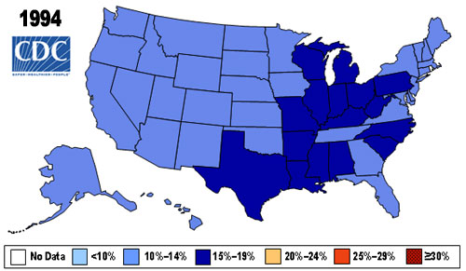
Overweight Problem
Obese in the US (BMI > 30)
Source: Centers for Disease Control and Prevention, USA

Slide 7
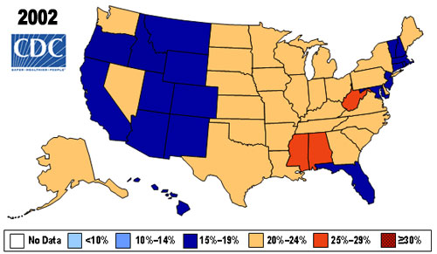
Overweight Problem
Obese in the US (BMI > 30)
Source: Centers for Disease Control and Prevention, USA

Slide 8
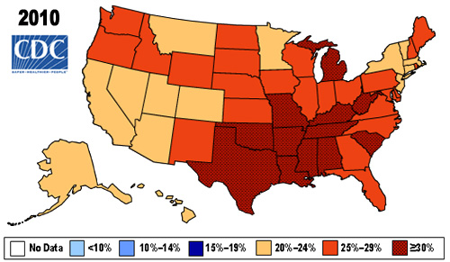
Overweight Problem
Obese in the US (BMI > 30)
Source: Centers for Disease Control and Prevention, USA

Slide 9
Activity in Switzerland
Activity according to age
Percentage of people regularly doing sport
Source: Bundesamt für Statistik Schweiz: Sport Schweiz 2008

Slide 10
Reasons for Inactivity
Source: Bundesamt für Statistik Schweiz: Sport Schweiz 2008, Das Sportverhalten der Schweizer Bevölkerung

Slide 11
2 Goals & Approach
Approaches and first Steps

Slide 12
Increase the number of active people

Slide 13
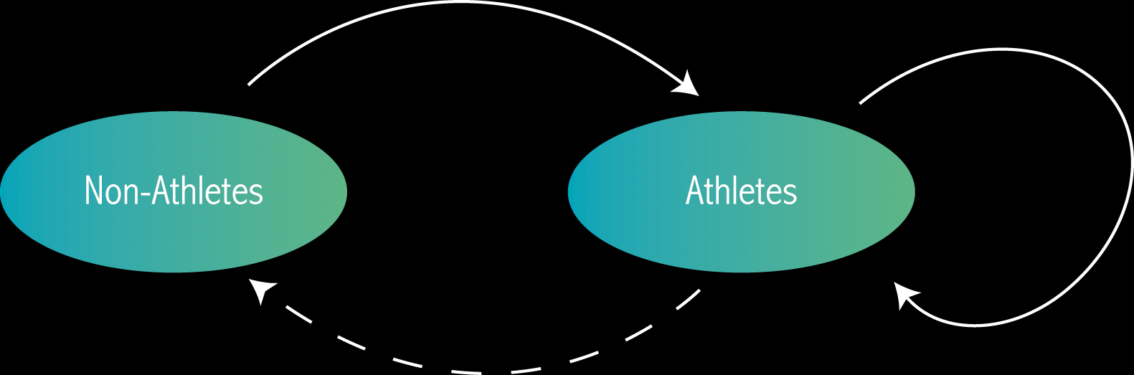
Different Approaches
Social aspect
Fun
Acknowledge
Goals
Progress
Competition

Slide 14
Different Approaches
Social aspect
Fun
Acknowledge
Goals
Progress
Competition

Slide 15
Different Approaches
Motivation / frame conditions
Social aspect
Fun
Acknowledge
Goals
Progress
Competition

Slide 16
Different Approaches
Motivation / frame conditions

Slide 17
Different Approaches
Motivation / frame conditions
Social aspect
Fun
Acknowledge
Goals
Progress
Competition

Slide 18
Different Approaches
Motivation / frame conditions
Social aspect
Fun
Acknowledge
Goals
Progress
Competition
Influence?

Slide 19

Different Approaches
Motivation / frame conditions
Social aspect
Fun
Acknowledge
Goals
Progress
Competition
Influence?

Slide 20
Different Approaches
Motivation / frame conditions
Social aspect
Fun
Acknowledge
Goals
Progress
Competition
Influence?

Slide 21
Different Approaches
How to increase motivation for
doing sport?
Motivation / frame conditions
Social aspect
Fun
Acknowledge
Goals
Progress
Competition
Influence?

Slide 22
Different Approaches
How to increase motivation for
doing sport?
Motivation / frame conditions
Social aspect
Fun
Acknowledge
Goals
Progress
Competition
Influence?
How to make sport more motivating
so people don’t quit?

Slide 23
Different Approaches
How to increase motivation for
doing sport?
Motivation / frame conditions
Social aspect
Fun
Acknowledge
Goals
Progress
Competition
Influence?
How to make sport more motivating
so people don’t quit?
How to influence inactive people
by active people?

Slide 24
Workflow
Develop
Focus
Finalize
Research
Data & Facts
Motivation
Sport psychology
Social effects
Team up
Build hypotheses
Different approaches
Tests / experiments
Analyze results
Validate hypotheses
Narrow topic
Choose approach
Find solution
Define product

Slide 25
Next Steps
Research
Partners
Data
Hypotheses
Target Group
Who am I designing for?
Who can help me?
Who shares the interest?
Data & facts
Scientific research
Build theories

Slide 26
3 Research Question

Slide 27
Developing Research Question
How must the frame conditions change to increase the number of active people?
How can you increase the motivation in sport?
Do athletes have an influence of non-athletes?
Can social media help to bring people to sport?

Slide 28
How can you increase the motivation or frame conditions for sport and how can you implement this in an interactive tool?

Slide 29
Questions / Discussion
?

